Slide 1
Professor X&Y re-work
Philipp Kratsch & Johnathan Hager

Slide 2
Objective
Re-work humanoid robots
Previously worked on by other graduate students
Two 12V car batteries replace with one 12v
Robot motors two 24V replace with 12v, if battery change
Bundle and Clean up wiring

Slide 3
Objective
Document the re-design
Documentation in progress
Tighten mechanical parts
Addition of other work
Other work was a complete mess
Spent several days trying to sort through

Slide 4
Problems
Previous problems we found with the parts
One of the arduino megas
Four Pololu motor control boards (For the actuators)
Roboclaw board (Driving motor control boards)
LEDs eyes
Servo eyebrows

Slide 5
Problems
Previous problems we found with the design
Overly complex
Nothing seemed to be working together, if at all

Slide 6
Re-design
Battery
Two 12v to One 12v car battery
Motors
Changed from 24v to 12v
Charging
Extension cord

Slide 7
Re-design
Physical switch to control
On, Off, and charging mode
Tighten mechanical parts
Straighten up the body
Fixed misaligned wheels
Checked every joint

Slide 8
Re-design
Bundle all wires
Removed all previous wiring (it was a mess)
Rewired everything for a cleaner look
Bluetooth control
Old usb dongle and hat (Worked intermittently)
New ESP32

Slide 9
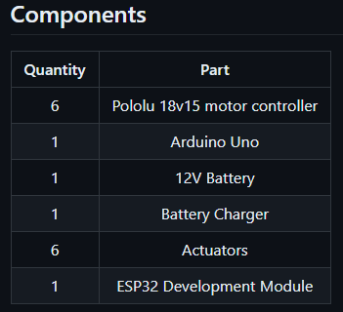
Components

Slide 10
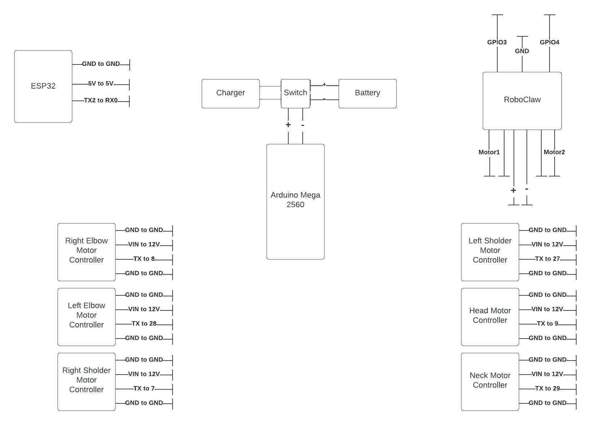
Wiring Diagram

Slide 11
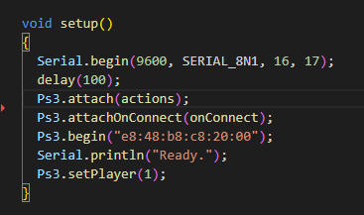
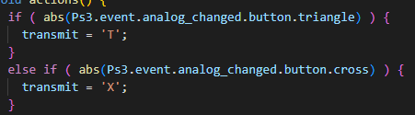
ESP32 - Controller

Slide 12

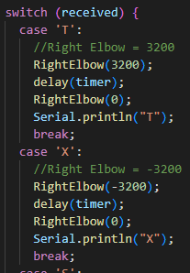
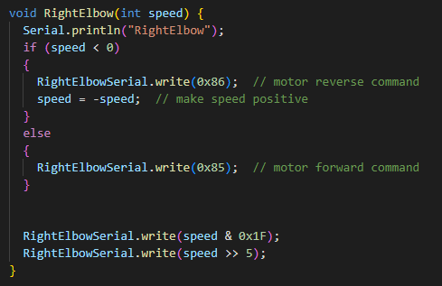
Arduino - Robot

Slide 13
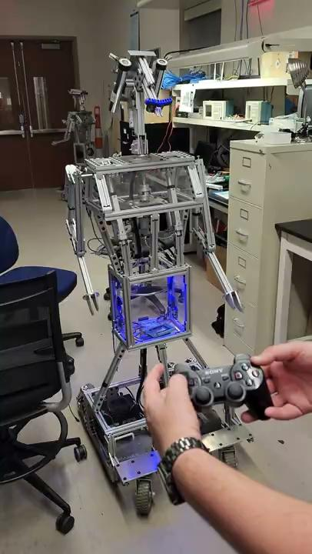
Demo
Video
Live

Slide 14
Recommend future work
Mechanically reworked
Less of a rigid design
Remove excess weight
Additions
New LEDs for the eyes
New servos for the eyebrows
Speakers
Custom PCB for wiring and components

Slide 15
References
Listed in github repo
https://github.com/kratzsci/ProfessorXY/blob/main/README.md

